Slide 1
Survival Analysis
Survival analysis corresponds to a set of statistical approaches used to investigate the time it takes for an event of interest to occur.
Survival Analysis is used to estimate the lifespan of a particular population under study. It is also called ‘Time to Event’ Analysis as the goal is to estimate the time for an individual or a group of individuals to experience an event of interest.
This time estimate is the duration between birth and death events. Survival Analysis was originally developed and used by Medical Researchers and Data Analysts to measure the lifetimes of a certain population. But, over the years, it has been used in various other applications such as predicting churning customers/employees, estimation of the lifetime of a Machine, etc.

Slide 2
Survival analysis is used in a variety of field such as:
Cancer studies for patients' survival time analyses,
Sociology for “event-history analysis”,
Engineering for “failure-time analysis”.
Time the average person lives, from birth.
Time after cancer treatment until death.
Time from first heart attack to the second.
Time from HIV diagnosis to AIDS development.
Time from manufacture of a component-to-component failure.

Slide 3
What is survival analysis used for?
What are the lifespan characteristics of a particular species?
In a particular setting, such as a country, how long do people live? How does the survival rate change for different age groups such as infants, children, adults and the elderly?
In a manufactured product, such as a structural beam, at what load weight do over 1% or 5% of the units fail?
Of patients diagnosed with a particular form of cancer, how do various medical treatments affect lifespan, prognosis or likelihood of remission?
How do manufacturing processes (e.g., temperature, time, material composition, etc.) affect the failure rate of a product (such as a structural beam)?

Slide 4
Kaplan Meir Analysis
The Kaplan–Meier estimator, also known as the product limit estimator, is a non-parametric statistic used to estimate the survival function from lifetime data. In medical research, it is often used to measure the fraction of patients living for a certain amount of time after treatment. In other fields, Kaplan–Meier estimators may be used to measure the length of time people remain unemployed after a job loss,^{[3]} the time-to-failure of machine parts, or how long fleshy fruits remain on plants before they are removed by frugivores (kind of animal).

Slide 5
Kaplan–Meier analysis measures the survival time from a certain date to time of death, failure or other significant event. For example, it can be used to calculate:
How long people remain unemployed after a job loss.
How long it takes for couples undergoing fertility treatment to get pregnant.
Time-to-failure of machine parts.

Slide 6
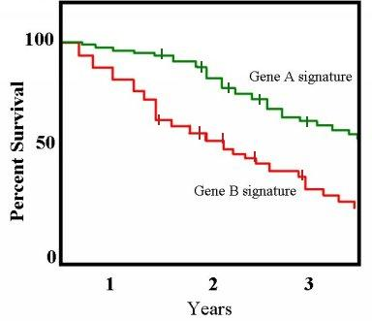
In medicine, Kaplan Meier Analysis is the simplest way to calculate survival time after treatment.
A graph of the Kaplan Meier estimator is a series of decreasing horizontal steps, which approaches the true survival function for that population given a large enough sample size. This graph shows two groups of patients: one with gene profile A and one with gene profile B. People with gene B die at a faster rate than those with gene A.

Slide 7
Complicating Factors
If every study participant is followed for the same length of time until their death, calculating the survival time is as easy as figuring out the fraction of surviving participants at any point in time. However, in the real world, complicating factors often make this task impossible. For example, calculating survival time can become complicated in clinical trials with factors like:
Patients that drop out of the study either on purpose or because they lose touch with the researcher.
Patients who are still alive at the end of the study, but who are expected to die (or do die) at a later date.
Patients who enter the study at a later date than other patients.
Kaplan Meier Analysis is an effective tool for calculating survival time despite these factors, which collectively are called “censored” participants. Two outcomes are possible: either the study participant has the event outcome (i.e. they die), or they do not (i.e. they are censored).

Slide 8
Performing Kaplan Meier Analysis
Survival probability = number of participants surviving / number of participants at risk
Participants are not counted in the denominator (participants at risk) if they have dropped out, died, or not reached that time yet. The probability of survival to any point is the cumulative probability of surviving the preceding time intervals.
Actually, calculating the Kaplan Meier analysis is usually performed with statistical software.
SPSS
OriginPRo
Excel

Slide 9
Social Network Analytics
Social network analysis (SNA) tools are used to analyze patterns of relationships among people in groups. They are useful for examining the social structure and interdependencies (or work patterns) of individuals or organizations.
A network is simply a number of points (or 'nodes') that are connected by links. Generally in social network analysis, the nodes are people and the links are any social connection between them – for example, friendship, marital/family ties, or financial ties.

Slide 10


Slide 11
Social Network Analysis (SNA), also known as network science, is a general study of the social network utilizing network and graph theory concepts. It explores the behavior of individuals at the micro-level, their relationships (social structure) at the macro level, and the connection between the two.
SNA uses several methods and tools to study the relationships, interactions, and communications in a network. This study is key to procedures and initiatives involving problem-solving, administration, and operations of that network.

Slide 12
The basic entities required for building a network are nodes and the edges connecting the nodes. Let us try and understand this with the help of a most common application of SNA, the Internet. Webpages are often linked to other web pages on their own page or other pages. In SNA language, these pages are nodes, and the links between the pages are the edges. In this way, we can interpret the entire internet as one large graph.

Slide 13
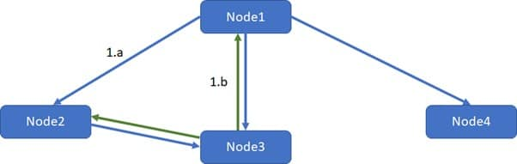
SNA Terminologies
As established earlier, nodes and edges are the building blocks for SNA. Few characteristics of the edges that define the features of a network are shown in the figure.

Slide 14
The Edges connect the Nodes. The direction of connections determines the Edge type.
1.a Directed Edge: The nodes connected by this edge are ordered, that is, the connection between the nodes is one way. For example, Twitter, Instagram are predominantly directed edge networks. You can follow someone without them following you back.
1.b Undirected Edge: The relationship between the nodes connected by this edge is mutual, i.e., the connection is applicable both ways. E.g., Befriending a person on Facebook, LinkedIn automatically creates a two-way connection.

Slide 15
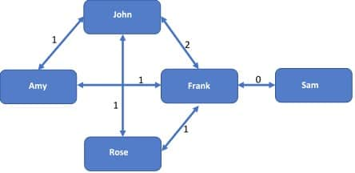
2. Weight: In a weighted network, an edge carries a label (weight) between the nodes. Different applications can have their own definition of weight. In social media analysis, a weight can define the number of mutual connections between the nodes connected by that edge.
In Figure , John and Frank have two mutual friends, Rose and Amy. Thus, the edge connecting John and Frank carries a weight of 2.

